Slide 1
Retail Sales Analytics
Monitoring Business Sales Performance
PRESENTED BY :
SURENDARSAI K
MENTOR : PRAKALYA GAYATHRI

Slide 2
Objective
This project develops a retail sales analytics solution to analyze sales performance, order trends, inventory, and customer behavior. Cleaned data from Excel was analyzed using SQL for business insights and Python for RFM analysis and customer segmentation.
The main objectives of my project are to analyze sales and order performance, understand product and inventory levels, analyze customer purchasing behavior, and finally present these insights through interactive Power BI dashboards

Slide 3
Problem Statement
  Retail businesses generate large volumes of sales, order, product, inventory, and customer data.
  Analysing this data manually makes it difficult to identify important trends and performance patterns.
  It is challenging to identify high-value customers, low-stock products, and variations in sales performance across stores, products, and locations.
  A centralized analytical dashboard is needed to transform the data into clear and actionable business insights.

Slide 4
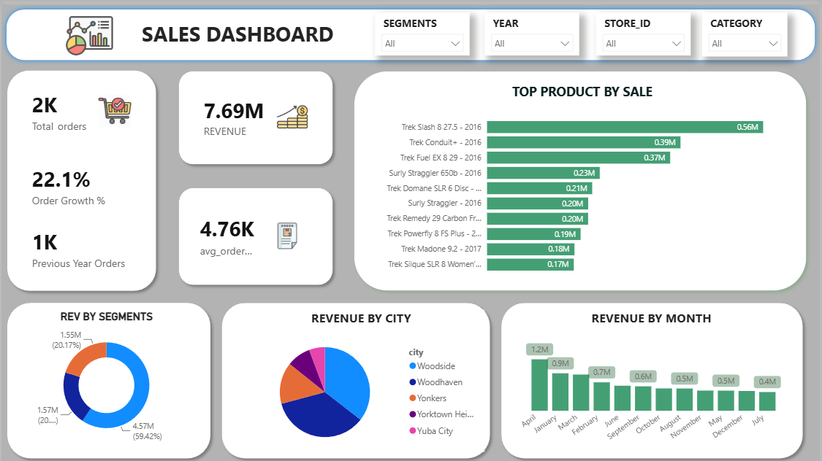
Sale Performance

Slide 5
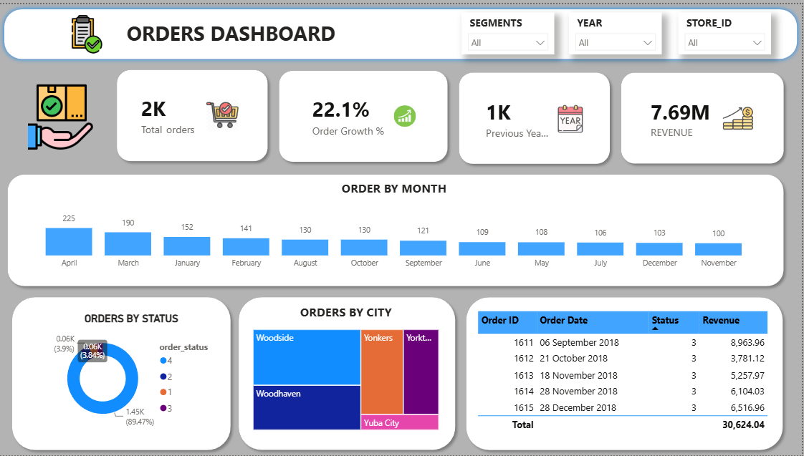
Order Performance

Slide 6
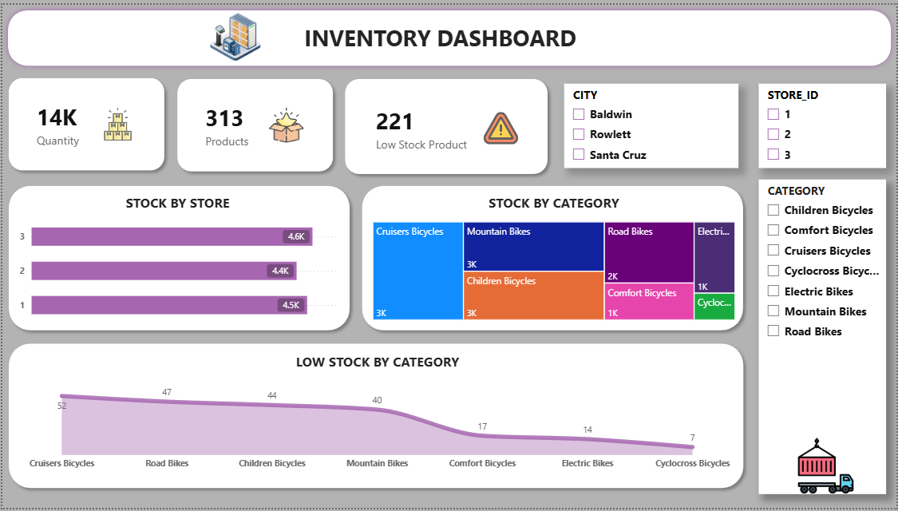
Inventory

Slide 7
Conclusion
  This project helped me transform cleaned data into meaningful business insights. I used Excel for data preparation, SQL for business analysis, Python for RFM-based customer segmentation, and Power BI for interactive visualization.
  Through this analysis, I was able to understand sales performance, inventory conditions, and customer behavior.
  This project also helped me understand how different data analytics tools can be combined to solve a business problem and support data-driven decision-making.
Thank You

